Slide 1
The Messages of Modesty

Slide 2
Crucial Question
“Is there an understandable biblical pattern of public modesty that applies to men and women regardless of culture or situation?”

Slide 3
Biblical Definition
“Modesty is a respectable manner of adorning one’s body and carrying oneself, born out of a freedom from a worldly definition of beauty and worth, and motivated by a hatred of sin and a desire to draw attention to God”

Slide 4
Message: Grace Changes Us Inside-Out
Living in the grace of God (Tit. 2:11-15)
This issue is not merely about clothing – it is about presenting Christ to the world (Rom. 12:1-2).
Our bodies are the temple of the Holy Spirit and should be the embodiment of God’s message to the lost (1 Cor. 6:19-20).

Slide 5
Message: Grace Changes Us Inside-Out
Modesty is rooted in Christ-like character (1 Tim. 2:9-10)
Example & Influence: “Proper clothing” (NASB), “modest apparel” (KJV):
”Respectable,” “honorable” (BAGD, 445)
“Orderly,” “decent” (Thayer, 356)
“The well ordering is not of dress and demeanor only, but the inner life’s expressing itself in the outward life” (Trench’s Syn.)

Slide 6
Message: Grace Changes Us Inside-Out
Your dress expresses who you are to those around you!
Ask yourself:
“What am I trying to accomplish by what I wear?”
“What messages am I sending to others by what I wear?”

Slide 7
Message: Grace Changes Us Inside-Out
Character and integrity: “Modestly” (NASB), “shamefacedness” (KJV), or “propriety” (NKJV)
“A state of mind or attitude necessary for one to be concerned about modesty” (Pastoral Epistles, Knight)
“A moral feeling, reverence…respect for the feeling or opinion of others or for one’s own conscience and so self-respect…sense of honor” (ibid.)
“A sense of shame prominently objective in its reference…Modesty rooted in character” (Vine’s Dict., IV, 17)

Slide 8
Message: Grace Changes Us Inside-Out
Wisdom: “Sobriety” (KJV), “Discreetly” (NASB)
Can I sit, walk, sit, kneel, or bend over?
Am I “naked” according to biblical standards?
Does my clothing emphasize parts of my body that would tend to entice others to lust or indicate a lack of character?
What kind of influence will my clothing have on others?

Slide 9
Message: We Can Know What is Modest
The Scriptures do not restrict the biblical definition of “nakedness” to absolute nudity (Exod. 28:42; Nahum 3:5; Isa. 47:2-3; John 21:7).
Can the Bible teach us truth both explicitly and implicitly? What about “profanity” and “giving” in the NT?

Slide 10
Message: We Can Know What is Modest
Ways one can be immodest:
Too short (revealing the thighs)
Too low off the shoulders (revealing shoulders, chest, and back)
Too tight, leggings
Short dresses, miniskirts
Split dresses, backless dresses, low-cut tops, dresses revealing cleavage and breasts

Slide 11
Message: We Can Know What is Modest
Swimsuits revealing large portions of the body (mixed swimming, public pool)
Shorts revealing the thigh
Men in public without their shirt on/wearing short-shorts
Wearing tight clothing

Slide 12
Message: We Can Know What is Modest
Non-Applicable Cultural Issue?
Paul’s teaching was very counter-cultural in Ephesus and the First Century
Scriptural principles are transcultural
Some are offering the same arguments advocates of same-sex relationships and female preachers/elders in the local church are making
Other cultures do dress immodestly, but also are involved in sexual immorality, polygamy, and idolatry

Slide 13
Message: We Can Know What is Modest
What is our Standard?
The totality and harmony of God’s teaching in direct statements, approved examples, and demanded conclusions (2 Tim. 3:16-17)
“No one else feels this way” (Jer. 10:23; Pro. 14:12; Isa. 55:8-9)
Is there any line one should not cross with clothing?

Slide 14
Message: We Can Know What is Modest
The Event is Not the Determination”
Wedding dresses
Athletic activities
Vacation, swimming, recreation
School /formal functions

Slide 15
Message: Biblical Modesty is Relevant to Men and Women
Men are responsible for sinful lusts regardless of the situation (Job 31:1)
Men are responsible for their own dress as well as women: “likewise” (1 Tim. 2:8-9)

Slide 16
Message: Biblical Teaching Applies to Men and Women
“For the lips of an adulteress (Heb. forbidden woman) drip honey, and her speech is smoother than oil; but in the end she is bitter as gall, sharp as a two-edged sword. Her feet go down to death; her steps lead straight to the grave. She gives no thought to the way of life; her paths wander aimlessly, but she does not know it…Keep to a path far from her, do not go near the door of her house, lest you lose your honor to others and your dignity to the one who is cruel”
(Proverbs 5:3-6, 8)

Slide 17
Message: Biblical Teaching Applies to Men and Women
“Do not desire her beauty in your heart, nor let her capture you with her eyelids…an adulteress hunts for the precious life. Can a man take fire into his bosom and his clothes not be burned? Or can a man walk on hot coals and his feet not be scorched?”
(Pro. 6:25-28).

Slide 18
Message: Biblical Teaching Applies to Men & Women
The description of the “forbidden woman” in Proverbs 7 includes “the dress of a harlot” (7:10)
Why would any husband want his wife to dress like a harlot for other men to see?
Why would any father take pride in his daughter dressing in an ungodly manner?
Why would we teach our sons to admire what is sinful?

Slide 19
Message: Biblical Teaching Applies to Men and Women Matthew 5:28; cf. Gen. 39:9, 13; 2 Tim. 2:22; Heb. 13:4
Are there men who will lust no matter what a woman wears? Yes
Are there men who are striving to keep their minds pure? Yes
Does your immodest dress have the potential to incite wrong thoughts in other striving to be godly? Yes
Can our dress show a lack of brotherly love? Yes
Should we have to fight this battle from Christians? No

Slide 20
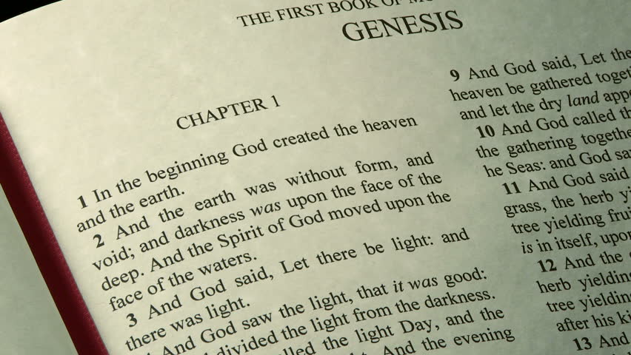
Message: Modesty Honors Marriage
Before sin – unashamed (Gen. 2:25)
After sin – ashamed (Gen. 3:7)
Given modest clothing (Gen. 3:21)

Slide 21
Message: Modesty Honors Marriage
“Drink water from your own cistern and fresh water from your own well. Should your springs be dispersed abroad, streams of water in the street? Let them be yours alone and not for strangers with you. Let your fountain be blessed and rejoice in the wife of your youth…Let her breasts satisfy you at all times; be exhilarated (intoxicated) always with her love. For why should you, my son, be exhilarated (intoxicated) with another man’s wife? Why embrace the bosom of a wayward woman?”
Proverbs 5:16-23

Slide 22
Message: Modesty Honors Marriage
Marriage is a Covenant Relationship (Mal. 2:14-16; Matt. 19:4-6)
“I am single” – why would you reveal aspects of your body to someone who is not your husband or wife?
“I am married” – Honor the covenant relationship in which you are living!

Slide 23
Messages of Modesty
“Grace changes us inside-out”
“We can know what is modest”
“Biblical Modesty is Relevant to Men and Women”
“Modesty Honors the Beauty & Power of Marriage”

Slide 24
Messages of Modesty
Modesty frees us from slavery to a hyper-sexualized culture
Shows that parents can shepherd their children in holiness and grace
Reveals the life-changing work of a faithful church
Preaching about modesty expresses brotherly love

Slide 25
The Messages of Modesty

Slide 26
Crucial Question
“Is there an understandable biblical pattern of public modesty that applies to men and women regardless of culture or situation?”

Slide 27
Biblical Definition
“Modesty is a respectable manner of adorning one’s body and carrying oneself, born out of a freedom from a worldly definition of beauty and worth, and motivated by a hatred of sin and a desire to draw attention to God”

Slide 28
Messages of Modesty
“Grace changes us inside-out”
“We can know what is modest”
“Biblical Modesty is Relevant to Men and Women”
“Modesty Honors the Beauty & Power of Marriage”

Slide 29
Message: Freedom From a Hyper-Sexualized Culture
American Psychological Association
“In study after study, findings have indicated that women more often than men are portrayed in a sexual manner (e.g., dressed in revealing clothing, expressing bodily postures or facial expressions that imply sexual readiness) and are objectified (e.g., used as a decorative object, or as body parts rather than a whole person).”

Slide 30
Message: Freedom From a Hyper-Sexualized Culture
Research links sexualized objectification of young women with three of the most common mental health problems of girls and women: eating disorders, low self-esteem, and depression.
Sexual objectification of women has been found to damage their self-image, ability to have a mature personal relationship with a man, and general success in life

Slide 31
Message: Parents Can Talk To Their Children About Grace and Holiness
Tune in, listen and talk openly
Don’t be afraid of questioning choices
Encourage and educate
Be consistent and model what you are teaching
Begin early

Slide 32
Isaiah 3:8-9 ESV: “For Jerusalem has stumbled and Judah has fallen, because their deeds are against the Lord defying his glorious presence [Hebrew: ‘the eyes of his glory’]. For the look on their faces bears witness against them; they proclaim their sin like Sodom; they do not hide it…”

Slide 33
Message: Parents Can Talk To Their Children About Grace and Holiness
Keys for Parents:
Begin early – don’t allow immodesty until your son or daughter is sixteen and then expect immediate change
Take the lead – don’t expect someone else to do it
Teach by your words and example
Surround your family with a spiritual sound environment in a faithful church

Slide 34
Message: Parents Can Talk To Their Children About Grace and Holiness
Fathers – Be present, wise, courageous, loving, and discerning
Mothers – Teach, support and encourage godly leadership

Slide 35
Message: Faithful Churches Teach on Modesty
NT addresses sexual immorality of all kinds (Gal. 5:19, 21; Col. 3:5)
Edification instructs and equips (Eph. 4:11-16)
Works of shepherds (Acts 20:28; Heb. 13:17; 1 Pet. 5:1-4)

Slide 36
Message: Faithful Churches Teach on Modesty
Influence of deacons (1 Tim. 3:8, 9, 13)
Gospel preachers and bible class teachers (1 Tim. 4:6; 2 Tim. 4:2-5)
All devoted Christians (Tit. 2:1-8)

Slide 37
Message: Faithful Churches Teach on Modesty - Consequences of Silent Pulpits
Disregard for God’s word (John 12:47-48)
Defiles and sears the conscience (1 Tim. 4:7)
Creates a compromising environment concerning other controversial, but vital biblical issues (2 Tim. 4:2-4)
Loss of godly shame (Jer. 6:15; 8:12)
Leads to conformity to the world, rather than transformation in Christ (Rom. 12:2)

Slide 38
Message: True Expression of Brotherly Love
We can teach the truth lovingly and firmly (Eph. 4:15; Jude 22-23)
Concern for the souls of every generation (Jud. 2:7-19; 1 Pet. 1:13-16)
Modesty is a gift to others
Modesty is an act of brotherly love
Biblical solution to sensual temptation
Reveals God’s care for the whole person

Slide 39
The Messages of Modesty

